Slide 1
Introduction To PHP

Slide 2
Introduction to PHP
PHP (Hypertext Preprocessor) is a popular server-side scripting language used to create dynamic and interactive web applications. It works with HTML to generate web pages, handle forms, and interact with databases.

Slide 3
Why Use PHP?
✅ Easy to Learn ✅ Open Source (Free to use) ✅ Works with almost all Databases (MySQL, PostgreSQL, MongoDB) ✅ Cross-Platform (Works on Windows, Linux, Mac) ✅ Wide Community Support
How PHP Works?
The client (browser) sends a request to the server.
The server processes the PHP code.
PHP generates HTML content dynamically.
The server sends the final HTML page to the browser.

Slide 4
Basic PHP Syntax
<?php
echo "Hello, World!";
?>

Slide 5
PHP Comments & Variables
PHP Comments
Comments in PHP are used to add explanations or disable parts of the code. They are ignored during execution.
Types of Comments in PHP
1️Single-line comment (// or #)
// This is a single-line comment
# This is also a single-line comment
echo "Hello, World!";
2️Multi-line comment (/* ... */)
/*
This is a multi-line comment.
It spans multiple lines.
*/
echo "Welcome to PHP!";

Slide 6
PHP Variables
Rules for PHP Variables
✅ Must start with $ (e.g., $name, $age). ✅ Must start with a letter or underscore (_), but not a number. ✅ Can contain letters, numbers, and underscores ($user_name, $userAge). ✅ PHP variables are case-sensitive ($name and $Name are different).

Slide 7
Declaring Variables
<?php
$name = "John"; // String
$age = 25; // Integer
$height = 5.8; // Float
$isStudent = true; // Boolean
echo "Name: $name, Age: $age, Height: $height, Student: $isStudent";
?>

Slide 8
Variable Scope in PHP
Local Variables
Declared inside a function and can’t be accessed outside
<?php
function myFunction() {
$message = "Hello"; // Local variable
echo $message;
}
myFunction();
// echo $message; ❌ ERROR! $message is not accessible outside the function.
?>

Slide 9
Global Variables
Declared outside a function and accessible anywhere using global.
<?php
$site = "PHP World"; // Global variable
function showSite() {
global $site; // Accessing global variable
echo $site;
}
showSite();
?>

Slide 10
Static Variables
Retains its value even after the function exits.
<?php
function counter() {
static $count = 0; // Static variable
$count++;
echo $count . " ";
}
counter(); // Output: 1
counter(); // Output: 2
counter(); // Output: 3
?>

Slide 11
Variable Interpolation
PHP automatically replaces variable names inside double quotes ("").
$name = "Alice";
echo "Hello, $name"; // ✅ Output: Hello, Alice
echo 'Hello, $name'; // ❌ Output: Hello, $name (does not interpolate)

Slide 12
Constants in PHP
A constant is like a variable, but its value cannot be changed.
<?php
define("SITE_NAME", "MyWebsite"); // Defining a constant
echo SITE_NAME; // Output: MyWebsite
?>

Slide 13
PHP echo Statement
The echo statement in PHP is used to output data to the browser. It is one of the most commonly used functions for displaying text, variables, HTML, or any other output in PHP.
Basic Syntax of echo
<?php
echo "Hello, World!";
?>

Slide 14
Features of echo
✅ Can output multiple values (comma-separated). ✅ Faster than print (since it doesn’t return a value). ✅ Does not require parentheses (()), but can be used with them
echo with Variables
<?php
$name = "Alice";
$age = 25;
echo "My name is $name and I am $age years old.";
?>

Slide 15
Using echo with HTML
You can embed HTML inside echo to generate dynamic content.
<?php
echo "<h1>Welcome to My Website</h1>";
echo "<p>This is a paragraph.</p>";
?>

Slide 16
Single vs Double Quotes in echo
Double quotes ("") allow variable interpolation (expanding variables inside the string). Single quotes ('') treat everything as a string.
<?php
$name = "Alice";
echo "Hello, $name"; // ✅ Output: Hello, Alice
echo 'Hello, $name'; // ❌ Output: Hello, $name (does not expand the variable)
?>

Slide 17
Using echo with Concatenation (.)
If you use single quotes, or want to combine text and variables, use concatenation (. operator).
<?php
$name = "Bob";
echo 'Hello, ' . $name . '!'; // ✅ Output: Hello, Bob!
?>

Slide 18
echo with HTML Attributes
You can dynamically add values inside HTML attributes.
<?php
$color = "blue";
echo "<p style='color: $color;'>This is a blue paragraph.</p>";
?>

Slide 19
PHP Data Types
In PHP, data types define the kind of values a variable can hold. PHP is a loosely typed language, meaning you don’t need to specify the data type—it is automatically determined based on the assigned value.

Slide 20
PHP Supports 8 Primary Data Types
PHP data types can be categorized into: 1️Scalar Types (Single values)
String
Integer
Float (Double)
Boolean
2️Compound Types (Multiple values)
Array
Object
3️Special Types
NULL
Resource

Slide 21
<?php
// String
$stringVar = "Hello, PHP!";
var_dump($stringVar); // Output: string(12) "Hello, PHP!"
// Integer
$intVar = 100;
var_dump($intVar); // Output: int(100)
// Float
$floatVar = 99.99;
var_dump($floatVar); // Output: float(99.99)
// Boolean
$boolVar = true;
var_dump($boolVar); // Output: bool(true)
// Array
$arrayVar = array("Apple", "Banana", "Cherry");
var_dump($arrayVar); // Output: array(3) { [0]=> string(5) "Apple" [1]=> string(6) "Banana" [2]=> string(6) "Cherry" }
// NULL
$nullVar = null;
var_dump($nullVar); // Output: NULL
?>

Slide 22
PHP Strings & Important String Functions
A string in PHP is a sequence of characters enclosed in single quotes (') or double quotes (").
<?php
$string1 = "Hello, World!";
$string2 = 'PHP is awesome!';
echo $string1;
?>
strlen() – Get String Length
Returns the number of characters (including spaces) in a string.

Slide 23
<?php
$text = "Hello PHP!";
echo strlen($text); // Output: 10
?>
str_word_count() – Count Words in a String
Counts the number of words in a string.
<?php
$text = "PHP is a great language!";
echo str_word_count($text); // Output: 5
?>

Slide 24
strrev() – Reverse a String
Reverses the given string.
<?php
echo strrev("Hello"); // Output: olleH
?>
strpos() – Find Position of a Substring
Finds the position of the first occurrence of a substring in a string.
<?php
$text = "Hello PHP!";
echo strpos($text, "PHP"); // Output: 6
?>

Slide 25
str_replace() – Replace a Substring
eplaces all occurrences of a substring with another substring.
<?php
$text = "I love JavaScript!";
echo str_replace("JavaScript", "PHP", $text);
// Output: I love PHP!
?>

Slide 26
strtoupper() & strtolower() – Change Case
strtoupper() → Converts string to uppercase. strtolower() → Converts string to lowercase.
<?php
$text = "Hello World!";
echo strtoupper($text); // Output: HELLO WORLD!
echo strtolower($text); // Output: hello world!
?>

Slide 27
PHP Numbers
PHP supports two main types of numbers: 1️Integer – Whole numbers (e.g., 10, -50, 1000) 2️Float (Double) – Decimal numbers (e.g., 3.14, -0.99, 2.5e3)

Slide 28
PHP Number Functions
PHP provides built-in functions to work with numbers.
Function | Description | Example
is_int() | Checks if a variable is an integer | is_int(10) → true
is_float() | Checks if a variable is a float | is_float(3.14) → true
is_numeric() | Checks if a variable is a number or a numeric string | is_numeric("100") → true
round() | Rounds a float to the nearest integer | round(3.6) → 4
ceil() | Rounds up a number | ceil(3.1) → 4
floor() | Rounds down a number | floor(3.9) → 3
abs() | Returns the absolute value | abs(-10) → 10
sqrt() | Returns the square root | sqrt(25) → 5
pow() | Raises a number to a power | pow(2, 3) → 8
rand() | Generates a random number | rand(1, 100) → (random number)

Slide 29
Example using Number Functions
<?php
$num = -25.75;
echo abs($num); // Output: 25.75
echo round(4.6); // Output: 5
echo ceil(4.2); // Output: 5
echo floor(4.8); // Output: 4
echo sqrt(16); // Output: 4
?>

Slide 30
PHP Type Casting (Converting Data Types)
PHP automatically converts variables between types when needed (type juggling). However, you can manually convert (cast) a variable to a specific type.
Type Casting Syntax
To cast a variable, use (type) before the value.
$var = "100";
$intVar = (int) $var; // Convert to integer

Slide 31
<?php
$num = "100.99";
// Convert to Integer
$intVal = (int) $num;
echo $intVal; // Output: 100
// Convert to Float
$floatVal = (float) $num;
echo $floatVal; // Output: 100.99
// Convert to Boolean
$boolVal = (bool) $num;
echo $boolVal; // Output: 1 (true)
// Convert to String
$stringVal = (string) 123;
echo $stringVal; // Output: "123"
?>

Slide 32
PHP Operators
Operators are used to perform operations on variables and values in PHP.
Types of Operators in PHP
🔹 1️Arithmetic Operators (Perform mathematical operations)

Slide 33
Operator | Name | Example | Output
+ | Addition | 5 + 3 | 8
- | Subtraction | 5 - 3 | 2
* | Multiplication | 5 * 3 | 15
/ | Division | 10 / 2 | 5
% | Modulus (Remainder) | 10 % 3 | 1
** | Exponentiation | 2 ** 3 | 8

Slide 34
Assignment Operators (Assign values to variables)
Operator | Example | Equivalent To
= | $a = 10 | $a = 10
+= | $a += 5 | $a = $a + 5
-= | $a -= 5 | $a = $a - 5
*= | $a *= 5 | $a = $a * 5
/= | $a /= 5 | $a = $a / 5
%= | $a %= 5 | $a = $a % 5

Slide 35
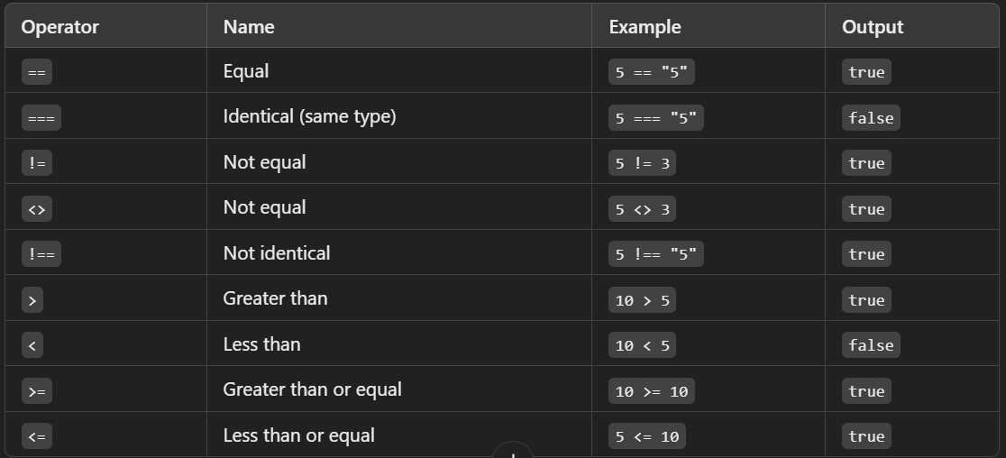

Slide 36
Logical Operators (Used for conditions)
Operator | Symbol | Description | Example (T/F) | Result
AND | && | Both must be true | T && F | F
OR | || | At least one true | T || F | T
NOT | ! | Inverts the value | !T | F
XOR | xor | Only one true | T xor F | T

Slide 37
Increment & Decrement Operators (Increase or decrease values)
Operator | Name | Example | Output
++$a | Pre-increment | $a = 5; ++$a; | 6
$a++ | Post-increment | $a = 5; $a++; | 6 (returns 5 first)
--$a | Pre-decrement | $a = 5; --$a; | 4
$a-- | Post-decrement | $a = 5; $a--; | 4 (returns 5 first)

Slide 38
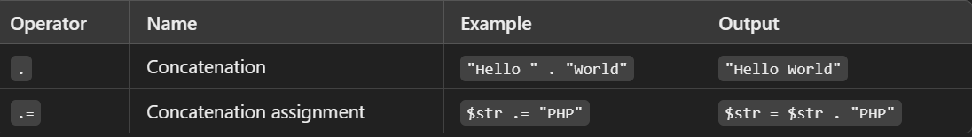
String Operators (Used for string manipulation)

Slide 39
Types of Conditions in PHP
if Statement
Executes code if the condition is true.
<?php
$age = 20;
if ($age >= 18) {
echo "You are an adult.";
}
?>

Slide 40
if...else Statement
Executes one block if true, another if false
<?php
$age = 16;
if ($age >= 18) {
echo "You can vote.";
} else {
echo "You cannot vote.";
}
?>

Slide 41
if...elseif...else Statement
Checks multiple conditions.
<?php
$score = 85;
if ($score >= 90) {
echo "Grade: A";
} elseif ($score >= 80) {
echo "Grade: B";
} else {
echo "Grade: C";
}
?>

Slide 42
Ternary Operator (? :) – Short If-Else
<?php
$age = 18;
echo ($age >= 18) ? "Adult" : "Minor";
?>

Slide 43
PHP Loops
Loops in PHP repeat a block of code until a condition is met.
for Loop – Used when you know the number of iterations
<?php
for ($i = 1; $i <= 5; $i++) {
echo "Number: $i <br>";
}
?>

Slide 44
while Loop – Runs while condition is true
<?php
$i = 1;
while ($i <= 5) {
echo "Number: $i <br>";
$i++;
}
?>

Slide 45
do...while Loop – Runs at least once, even if false
<?php
$i = 6;
do {
echo "Number: $i <br>";
$i++;
} while ($i <= 5);
?>

Slide 46
Creating a Function
Use function keyword to define a function.
<?php
function greet() {
echo "Hello, World!";
}
greet(); // Calling the function
?>

Slide 47
Function with Parameters
Parameters allow passing values to a function.
<?php
function greetUser($name) {
echo "Hello, $name!";
}
greetUser("Alice");
?>

Slide 48
Function with Return Value
Use return to send back a value.
<?php
function add($a, $b) {
return $a + $b;
}
$result = add(5, 3);
echo "Sum: $result";
?>

Slide 49
Anonymous (Lambda) Functions
Used for short, inline functions.
<?php
$greet = function($name) {
return "Hello, $name!";
};
echo $greet("Bob");
?>

Slide 50
PHP Arrays
An array in PHP is a collection of multiple values stored in a single variable.
Indexed Array (Numeric Keys)
Elements are accessed using numeric indexes (starting from 0).
<?php
$colors = ["Red", "Green", "Blue"];
echo $colors[0]; // Output: Red
?>

Slide 51
Associative Array (Named Keys)
Each key is a string instead of a number.
<?php
$student = ["name" => "John", "age" => 20, "grade" => "A"];
echo $student["name"]; // Output: John
?>

Slide 52
Multidimensional Array (Array Inside Array)
Used to store complex data.
<?php
$students = [
["Alice", 22, "A"],
["Bob", 21, "B"]
];
echo $students[0][0]; // Output: Alice
?>

Slide 53
Looping Through Arrays
Using foreach for Indexed Array
<?php
$colors = ["Red", "Green", "Blue"];
foreach ($colors as $color) {
echo "$color <br>";
}
?>

Slide 54
Using foreach for Associative Array
<?php
$student = ["name" => "John", "age" => 20, "grade" => "A"];
foreach ($student as $key => $value) {
echo "$key: $value <br>";
}
?>

Slide 55
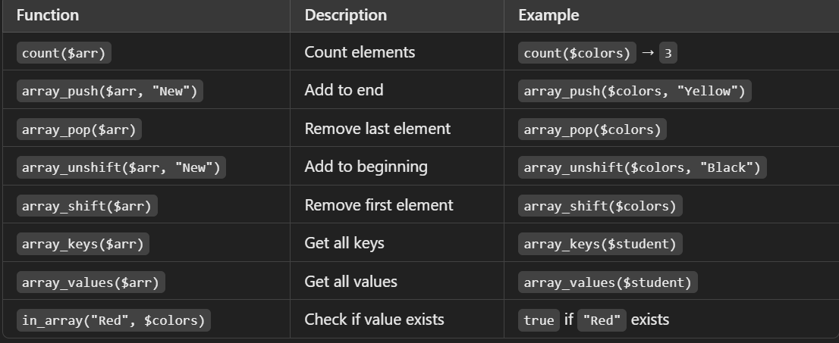
Useful Array Functions

